Slide 1
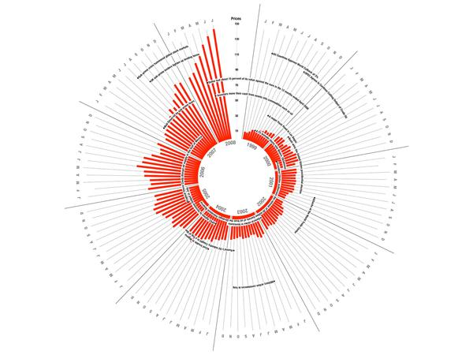
Data Visualization Colour
MSc Data Analytics – Data Visualisation Noel Cosgrave
Notes:
Much material in this section from http://www.sas.com/content/dam/SAS/en_us/doc/whitepaper2/hbr-persuading-with-data-107245.pdf
Andy Kirk companion website: http://www.visualisingdata.com/section/chapter-9/

Slide 2
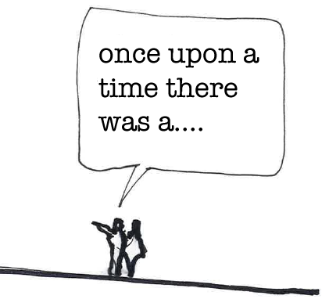
Data as stories
Turn data into stories
More persuasive
Good advice
Lack of tools
Graphs/Charts/Colours – useful in demonstrating the mechanics underpinning an effective story
Have enough visual description that audience can see what you’re seeing
No one is persuaded by something they don’t remember
Image source: https://jasonfurnell.wordpress.com/2011/03/01/tell-a-story/
Notes:
Business people are often advised to turn their data into stories to make them more persuasive. And that is certainly good advice. But they are given precious few tools to help them do that. It turns out though, John Keating notwithstanding, that graphs can be remarkably useful in demonstrating the mechanics underpinning an effective story. One person who’d given this a lot of thought was novelist Kurt Vonnegut, a real-life literary iconoclast if there ever was one.

Slide 3


To Tell Your Story, take a page from Kurt Vonnegut
Shapes of Stories
https://www.youtube.com/watch?v=oP3c1h8v2ZQ
Notes:
Short lecture by Kurt Vonnegut on the 'simple shapes of stories.'

Slide 4
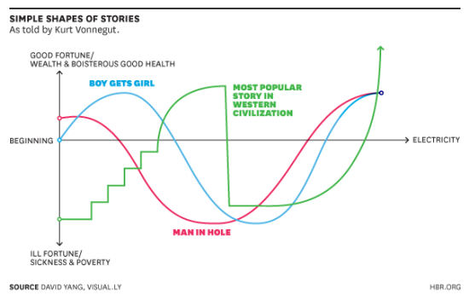
Simplicity
Simplicity that underlies apparent complexity
That’s what data are so good at doing
Keep colour simple
Image source: http://www.sas.com/content/dam/SAS/en_us/doc/whitepaper2/hbr-persuading-with-data-107245.pdf
Notes:
http://www.sas.com/content/dam/SAS/en_us/doc/whitepaper2/hbr-persuading-with-data-107245.pdf
But watch the video (it’s less than five minutes long), and two things become apparent. The first is certainly that so many successful business stories follow patterns embedded in Western civilization’s most primal literary conventions. It’s easy to see why marshaling data to tell one of these kinds of stories—rags turning into riches, mistakes rectified, challenges overcome, the right resources and the right contacts saving the day—would be so compelling. And there’s probably an argument here for reading more fiction, to give John Keating his due.
The second is that Vonnegut’s delivery matters as much as his ideas. His timing is perfect. His language is concrete and unexpected. He’s showing you the simplicity that underlies apparent complexity—that’s what data are so good at doing. But he’s just as concerned with making sure you’re paying attention—since no one is persuaded by something they don’t remember.

Slide 5

Colour
“Colours are perhaps the visual property that people most often misuse in visualization with-out being aware of it”
Robert Kosara (Tableau)
Image source: https://research.tableau.com/user/robert-kosara
Notes:
https://research.tableau.com/user/robert-kosara
Lots of papers/publications listed at this site

Slide 6
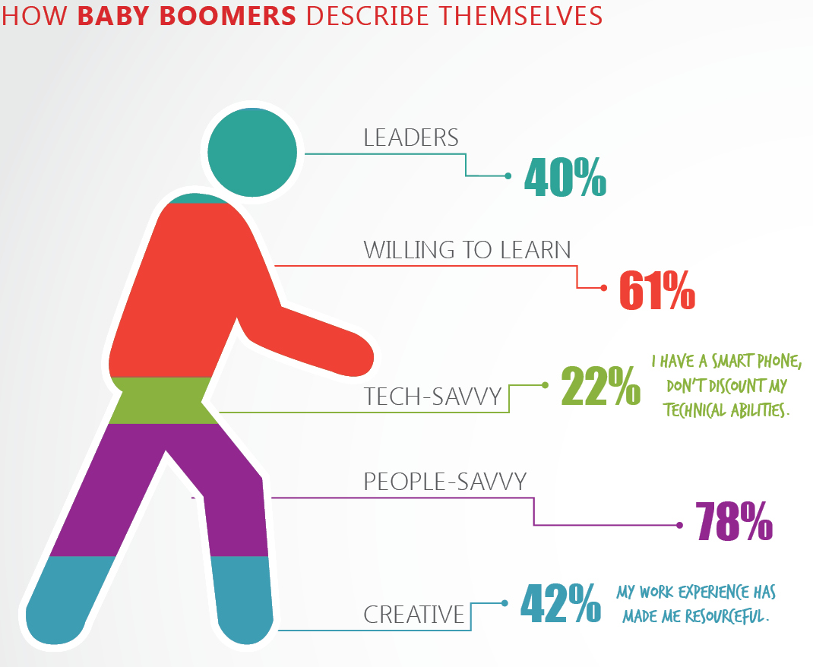
Key factor
Colour
Meaning first
Decoration last
Thinking
Begins from inside the chart(s)
Image source: http://gizmodo.com/8-horrible-data-visualizations-that-make-no-sense-1228022038

Slide 7
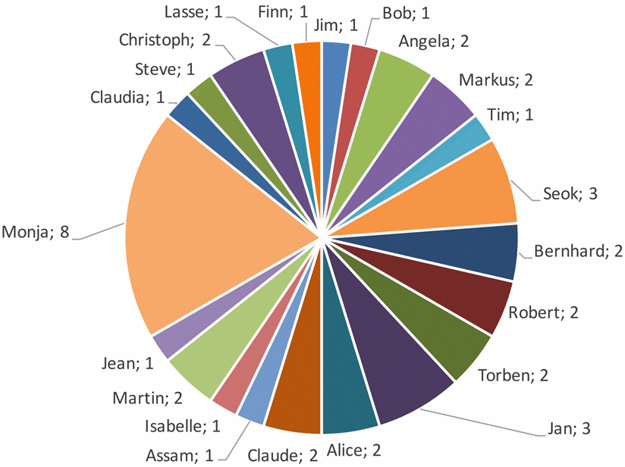
Visualizations that make no sense
“Furthermore, we present the distribution of attacks towards employees in detail in Fig. 10 right. The blue employees are secretaries, the green ones are administrators and the red ones are scientific employees. The number following the name is the number of times that person was attacked. All of the names are pseudonyms for real people. The person that suffered the most attacks is Monja a secretary with overall 8 attacks. In contrast, all other victims suffered between 1 and 3 attacks.”
Beckers & Pape (2016)
Image source: http://viz.wtf/
Notes:
From:
A Serious Game for Eliciting Social Engineering Security Requirements
http://ieeexplore.ieee.org/document/7765507/

Slide 8
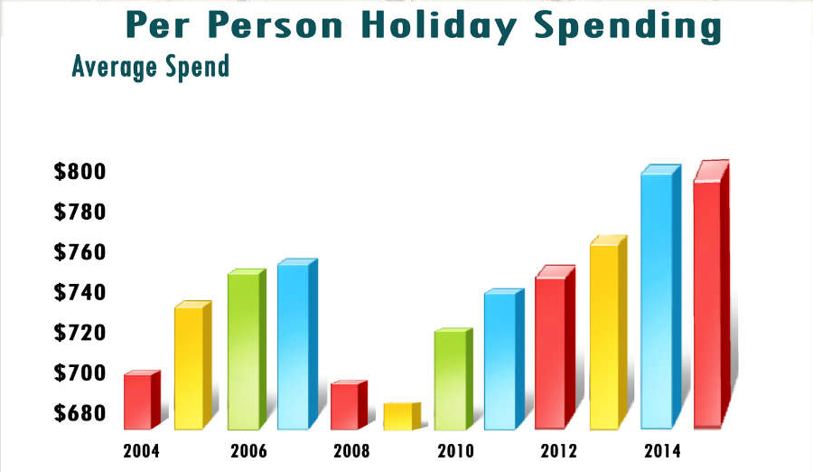
When colours have no meaning
Image source: http://visual.ly/christmas-and-new-year-holidays-around-world

Slide 9
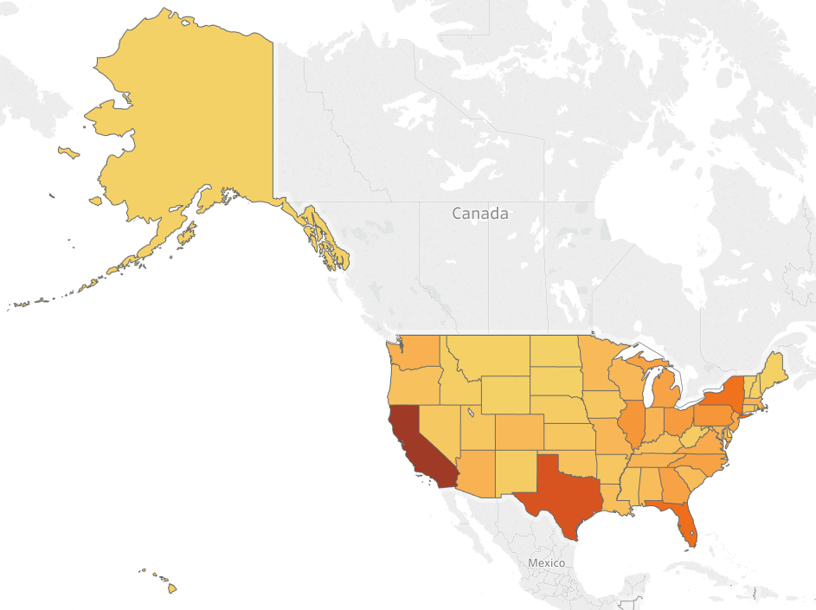
Short Exercise (Tableau)
Using colour to represent population
50 States
Excel file in Moodle
Create map
Edit colours
Use colour palettes

Slide 10
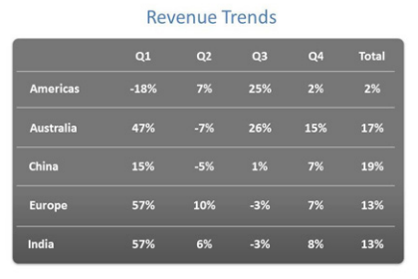
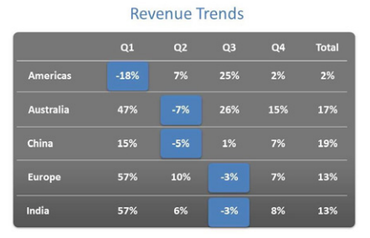
Simple Example
Are we comparing:
Regions?
Quarters?
Positive versus negative numbers?
It’s difficult to determine what matters most
By adding color, you can draw the eye to specific areas.
We now know that we should be focusing on when and in which regions revenue dropped
Notes:
Good use of colour

Slide 11
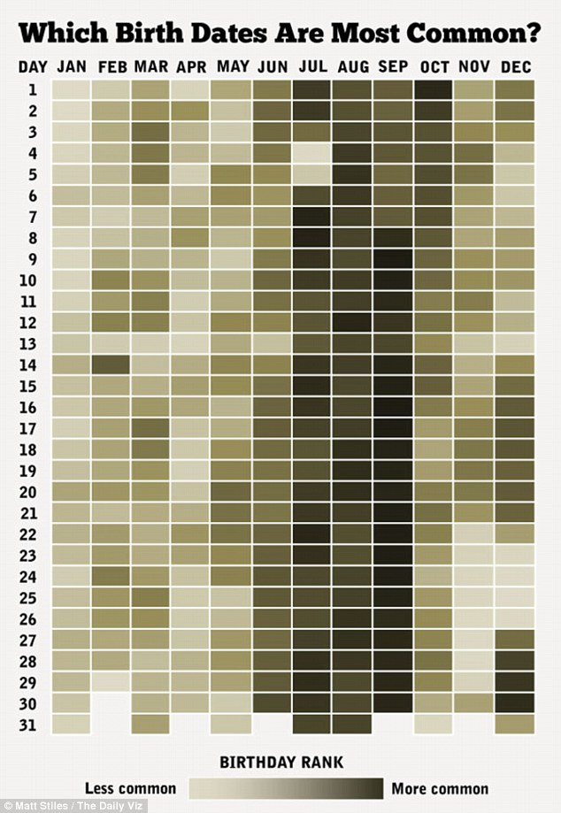
Which Birth Dates Are Most Common?
Data (USA)
Only one colour!
Relationship emerges very strongly
Do some exploring
Free to move around
Persuasive
Image source: http://literock969.com/how-common-is-your-birthday-chart-shows-most-least-common-birthdays-2/
Notes:
Take a look at the first infographic of the collection (Above). It’s very simple. It starts with a question: “Which Birth Dates Are Most Common?” And what we see is a chart that shows every day of the year in various shades of a single color. The darker the color, the more babies were born on that day in the U.S.
It’s effective because you can see all the data for the entire year, and yet the actual relationship emerges very strongly. You immediately see the dark band running through July, August, September, and into October. It’s very clear that more people are being born then.
Once you’ve seen the main relationship, you can look at other things, as well, which is very satisfying. You can see, for example, on July 4th and 5th there’s a sudden drop-off in people being born, presumably because it’s around the holidays—you can see the same thing around the Christmas holidays. But then if you look over at February 14th there’s a dark island where a lot of babies are being born. So you can see the main relationship, but then you can also do some exploring.
That’s an important part of its persuasiveness: You want to show someone something, but you also want to give them a sense that they’re free to move around and find their own relationships. When they do, they’ll have confidence that you really are giving them the whole story.

Slide 12
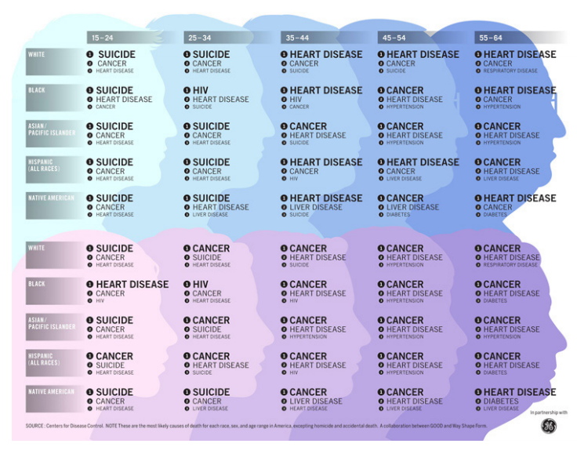
Cause of death
Complex story
Use Data Viz to tell story
Simple & Compelling
Colour is key
Three things you are most likely to die of
Source: http://www.sas.com/content/dam/SAS/en_us/doc/whitepaper2/hbr-persuading-with-data-107245.pdf
Notes:
From: HOW GE USES DATA VISUALIZATION TO TELL COMPLEX STORIES
http://www.sas.com/content/dam/SAS/en_us/doc/whitepaper2/hbr-persuading-with-data-107245.pdf
One of our first was back in 2009, and [it] was about causes of death. We separated them in[to] male versus female, and via age spans. So if you’re 24 to 36, or what have you, these are the three things you [are] most likely to die of. Now it seems so simple, but it was really compelling.
We got a tremendous response to it. The media loved it. Our different stakeholders—be it customers, employees—everybody thought, wow, what a great way to tell a story, and it was sort of born from that

Slide 13



The Right Colours Make Data Easier to Read
What is the color of money?
Of love?
Of the ocean?
“Semantically resonant color choices”
Ocean is blue
Love is red
Money is green
Notes:
Images from:
http://animal-dream.com/money.html
https://clipartfox.com/categories/view/7c1bd8b8ef876fdc76c1a5cd8c163a21b7458d44/red-love-heart-clipart.html
http://www.treehugger.com/ocean-conservation/scientists-listen-ocean-sounds-7-miles-down-heres-what-they-heard.html
What is the color of money? Of love? Of the ocean? In the United States, most people respond that money is green, love is red, and the ocean is blue. Many concepts evoke related colors—whether due to physical appearance, common metaphors, or cultural conventions. When colors are paired with the concepts that evoke them, we call these “semantically resonant color choices.”

Slide 14
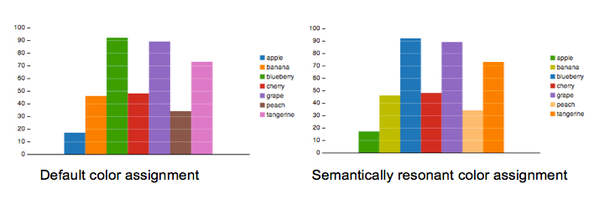
Semantically resonant color choices
Which fruit had higher sales: blueberries or tangerines?
How about peaches versus apples?
Image source: https://hbr.org/2014/04/the-right-colors-make-data-easier-to-read
Notes:
The only difference between the charts is the color assignment. The left-hand chart uses colors from a default palette. The right-hand chart has been assigned semantically resonant colors. (In this case, the assignment was computed automatically using an algorithm that analyzes the colors in relevant images retrieved from Google Image Search using queries for each data category name.)
Which chart do you find easier to read?

Slide 15
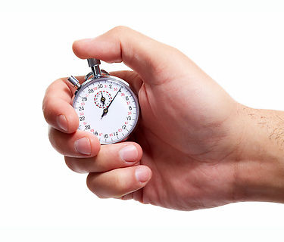
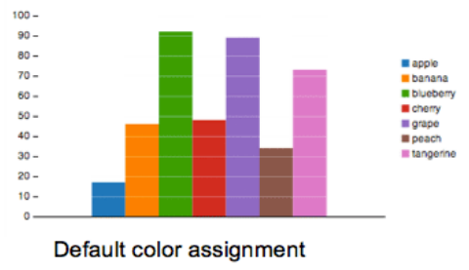
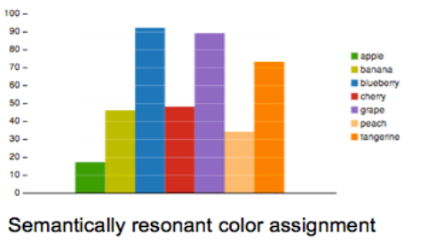
Impact of semantically resonant colors on graph analysis
On average, people took a full second less to complete a single comparison task when they were looking at semantically resonant colors
Image source: http://www.ebay.com/gds/Choosing-the-Right-Stopwatch-for-Your-Needs-/10000000178608506/g.html
Notes:
Which chart do you find easier to read?
If you answered the chart on the right, you’re not alone. To determine the impact of semantically resonant colors on graph analysis, we ran experiments to measure how quickly people can complete data-comparison tasks on bar charts using either default colors or semantically resonant colors.
On average, people took a full second less to complete a single comparison task when they were looking at semantically resonant colors (whether chosen by our algorithm or by an expert designer). T
hat may not sound like a lot but it’s about 10% of the total task time. These time savings can add up, particularly for data analysts making untold numbers of such comparisons throughout their workday.

Slide 16
What’s going on here?
Taking advantage of familiar existing relationships
Less conscious thought and speeding recall
Concept-color relationship is improved when looking at semantically resonant data
May not need to repeatedly look at the legend to remember which column is which
Focus more on the data
Notes:
We see a number of ways in which semantically resonant colors could be helping improve graph-reading performance.
First, semantically resonant colors can enable you to take advantage of familiar existing relationships, thus requiring you to use less conscious thought and speeding recall.
Non-resonant colors, on the other hand, can cause semantic interference: the colors and concepts interfere with each other (as anyone familiar with the famous Stroop test from psychology knows—the one in which you’re asked to name the text colors of color names printed in conflicting colors: green, red, and so on).
Second, because your recall of the concept-color relationship is improved when looking at semantically resonant data, you may not need to repeatedly look at the legend to remember which column is which, and so can focus more on the data itself.

Slide 17
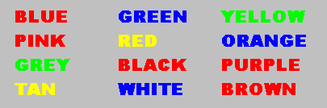
Stroop Test
Colours and concepts interfere with each other
Take the Test https://faculty.washington.edu/chudler/java/ready.html
Notes:
Original paper by Stroop (1935): http://psychclassics.yorku.ca/Stroop/

Slide 18
Effective visualization colour choices,
Discriminability
Colours need to be suitably different from one another so that readers can tell them apart
Colour Blindness
Inherited condition
8% of males and 0.4% of females
Difficulty distinguishing reds and greens (most common)
Difficulty distinguishing blues and greens (less common)
Notes:
Overview
Colour blindness may be a hereditary condition or caused by disease of the optic nerve or retina. Acquired colour vision problems only affect the eye with the disease and may become progressively worse over time.
Inherited colour blindness is most common affecting both eyes and does not worsen over time. This type is found in about 8% of males and 0.4% of females. These color problems are linked to the X chromosome and are almost always passed from a mother to her son. Colour blindness may be partial (affecting only some colours), or complete (affecting all colours). Complete colour blindness is very rare. People who are completely colour blind often have other serious eye problems as well.
Photoreceptors called cones allow us to appreciate colour. These are concentrated in the very centre of the retina and contain three photosensitive pigments: red, green and blue. People with defective colour vision have a deficiency or absence in one or more of these pigments. People with normal colour vision are referred to as trichromats. People with a deficiency in one of the pigments are called anomalous trichromats (the most common type of colour vision problem.) A dichromat has a complete absence in one cone pigment.
Signs and Symptoms
The symptoms of colour blindness are dependent on several factors, such as whether the problem is congenital, acquired, partial, or complete.
Difficulty distinguishing reds and greens (most common)
Difficulty distinguishing blues and greens (less common)
The symptoms of more serious inherited colour vision problems and some types of acquired problems may include:
Objects appear as various shades of grey (this occurs with complete colour blindness and is very rare)
Reduced vision
Nystagmus
Detection and Diagnosis
Colour vision deficiency is most commonly detected with special coloured charts called the Ishihara Test Plates. On each plate is a number composed of colored dots. While holding the chart under good lighting, the patient is asked to identify the number. Once the color defect is identified, more detailed colour vision tests may be performed.
Treatment
There is no treatment or cure for colour blindness. People with mild colour deficiencies learn to associate colours with certain objects and are usually able to identify colour as everyone else. However, they are unable to appreciate colour in the same way as those with normal colour vision.

Slide 19
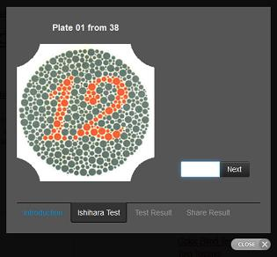
Ishihara 38 Plates CVD Test
Test for Red-Green colour blindness
Take the Test
http://www.color-blindness.com/ishihara-38-plates-cvd-test/#prettyPhoto
Notes:
http://www.color-blindness.com/ishihara-38-plates-cvd-test/#prettyPhoto

Slide 20
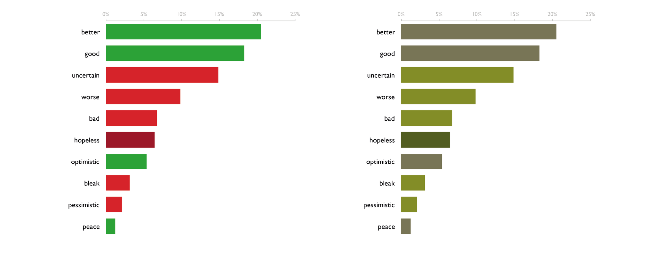
Accessible Design
Impact of Red-Green Colour Blindness
Simulated colour blindness.
What 8% males see!
Notes:
Demonstrating the impact of red-green colour blindness (deuteranopia).
Word-sentiment analysis: the reds and greens that most of us would easily discern (left), are often not at all distinguishable for those with colour blindness.
(General – green = good, red = bad).
If you have a large audience, could alienate 8% of males and 0.5% females.

Slide 21




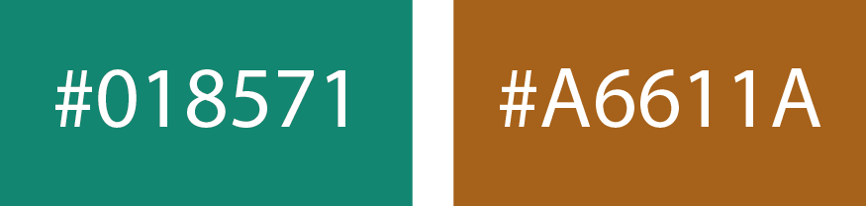
Consider other options
Colour blind friendly alternatives to green and red:
Kirk (2016, p287)
Notes:
Triangles – supplement with symbols, shapes encode the same meaning.

Slide 22



Cultural Differences
“Western” cultures – green associated with luck.
China - the color red symbolizes luck and is believed to ward away evil.
“Western” cultures – red associated with danger.
Notes:
Images sourced from:
https://clipartfest.com/download/deefdf70f7e41eeeeb1cf63a38bcfb88ab22c2ee.html
https://commons.wikimedia.org/wiki/File:Red_paper_lanterns,_Shanghai,_2012.jpg

Slide 23
Concept-colour association strength
Some concepts are simply more colorable than others
Gold
Silver
Cash
Social security National defense
Income security
vs
Notes:
Overall, we found that using semantically resonant colors for categories that were more colorable unsurprisingly tends to provide greater performance improvements.
Left: Easy to associate a colour
Right: Not so easy.

Slide 24
Gains
Semantically resonant colors can reinforce perception of a wide range of data categories
Consider color choice
Ask yourself:
how well the colours resonate with the underlying data

Slide 25
Exercise: World’s Most Valuable Brands
Rank | Brand | Value (B) | Revenue (B)
1 | Apple | $154.1 | $233.7
2 | Google | $82.5 | $69.5
3 | Microsoft | $75.2 | $87.6
4 | Coca-Cola | $58.5 | $21.9
5 | Facebook | $52.6 | $17.4
6 | Toyota | $42.1 | $165.1
7 | IBM | $41.4 | $81.7
8 | Disney | $39.5 | $28.0
9 | McDonald's | $39.1 | $82.7
10 | GE | $36.7 | $92.3
11 | Samsung | $36.1 | $177.4
12 | Amazon | $35.2 | $104.5
13 | AT&T | $32.6 | $146.8
14 | BMW | $28.8 | $82.8
15 | Cisco | $28.4 | $49.6
16 | Oracle | $28.0 | $37.2
17 | Intel | $27.7 | $55.4
18 | NIKE | $27.5 | $30.0
19 | Louis Vuitton | $27.3 | $10.0
20 | Mercedes-Benz | $26.0 | $105.8
Prepare Bar Chart (Excel)
Colorize individual companies
Minimum of FIVE companies
(File in Moodle)
Notes:
Choose colours that you think most appropriate for each company.
Check company’s web site for brand details.
Try a minimum of five brands for value.
More adventurous:
10, 15, or 20 brands!
Add in second column representing Revenue (B).
Instead of with colours use logos or graphics representing each company (fill each bar with a graphic)

Slide 26
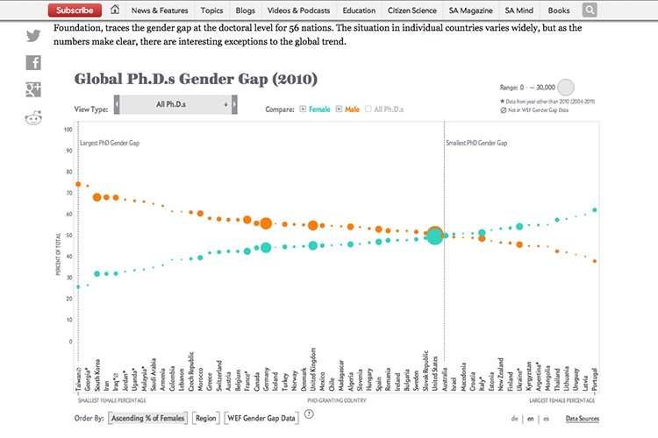
Simple Colour to Differentiate
How nations fare in PhDs by sex
Notes:
Kirk (2016, p268)
Just two colours to differentiate.

Slide 27
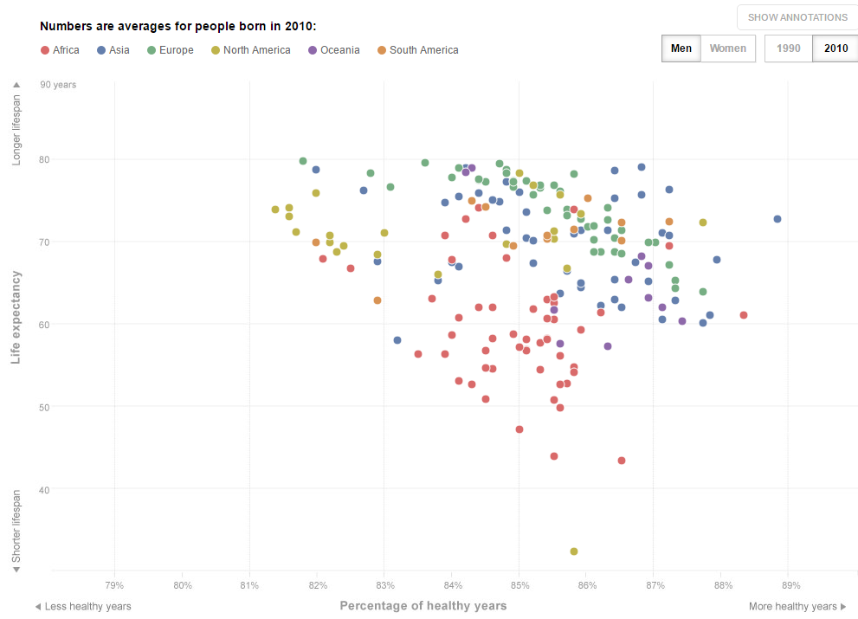
Assigning colours (4 -6 categories)
How long will we live — and how well?
http://www.washingtonpost.com/wp-srv/special/health/healthy-life-expectancy/
Notes:
Go to link.
Six colours for resions.

Slide 28
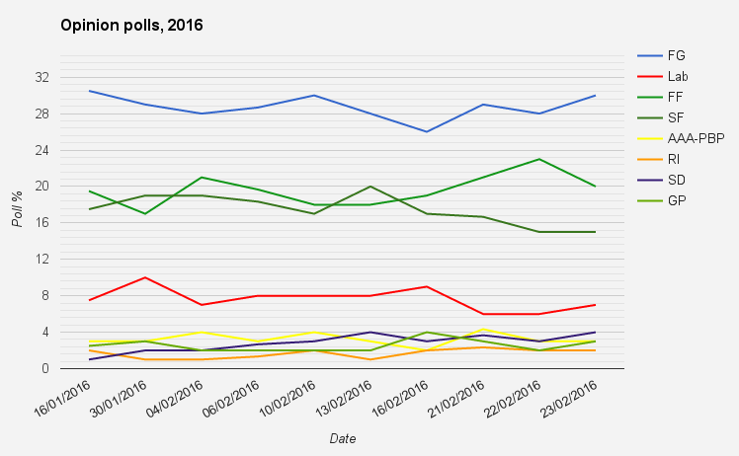
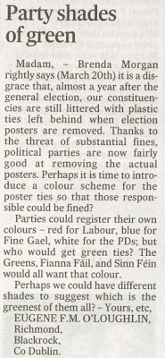
Colour in Trends (8 categories)
Irish Opinion Polls - 2016
The Irish Times
(24th March, 2008)
Image source: Wikimedia Commons.
Notes:
Green colour????
https://commons.wikimedia.org/wiki/File:Opinionpolls2016.png

Slide 29
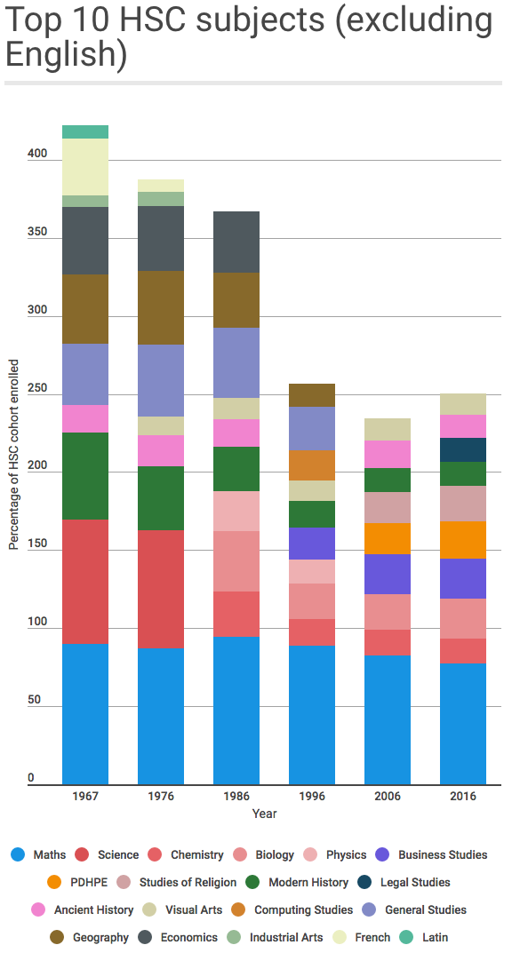
Rule of Thumb
As the range of different categories grows, the ability to preserve differentiation becomes harder
More than 12 categories – problem
Increases the demands of learning and recognition for viewers
Image source: http://viz.wtf/
Notes:
From http://viz.wtf/
19 colours!
Maths enrolments drop to lowest rate in 50 years. If students are expected to interpret this bar chart, it’s not hard to see why.

Slide 30
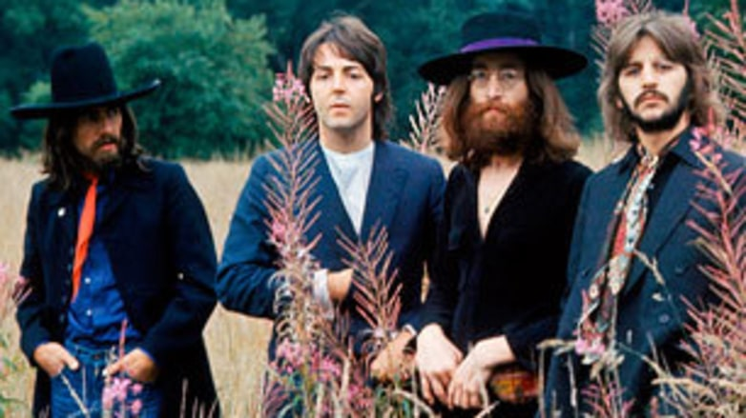
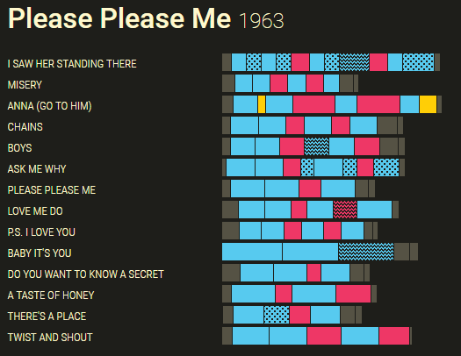
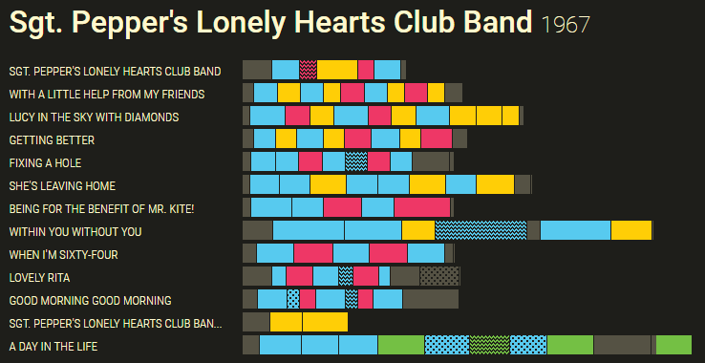
Charting The Beatles
Compare:
Image source: http://www.rollingstone.com/music/artists/the-beatles/biography
Consistency from song to song.
Collage of differing compositional styles (note patterns)
Images source: http://chartingthebeatles.com/#songstructure
Notes:
Charting the Beatles
Song Structure
How did the form of Beatles songs evolve?
Each song can be divided into sections such as verse, chorus, or bridge. By coloring the sections for every song, we see each album has its own structural identity.
For example, 'Please Please Me' has some consistency from song to song, where many songs have repeating verses with two bridges. In contrast, Sgt. Pepper' is a collage of differing compositional styles.
HICK: Overcome by supplementing use of colour with patterns. You can see two patterns being used occasionally as additive properties to show the structure of tracks on album.

Slide 31
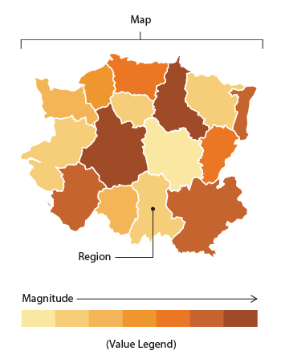
Using Colour to Represent Quantitative Data - Choropleth Maps
Choropleth Maps display divided geographical areas or regions that are coloured, shaded or patterned in relation to a data variable
This provides a way to visualise values over a geographical area, which can show variation or patterns across the displayed location.
Image source: http://www.datavizcatalogue.com/methods/choropleth.html
Notes:
Description
Choropleth Maps display divided geographical areas or regions that are coloured, shaded or patterned in relation to a data variable. This provides a way to visualise values over a geographical area, which can show variation or patterns across the displayed location.
The data variable uses colour progression to represent itself in each region of the map. Typically, this can be a blending from one colour to another, a single hue progression, transparent to opaque, light to dark or an entire colour spectrum.
One downside to the use of colour is that you can't accurately read or compare values from the map. Another issue is that larger regions appear more emphasised then smaller ones, so the viewer's perception of a shaded values are affected.

Slide 32
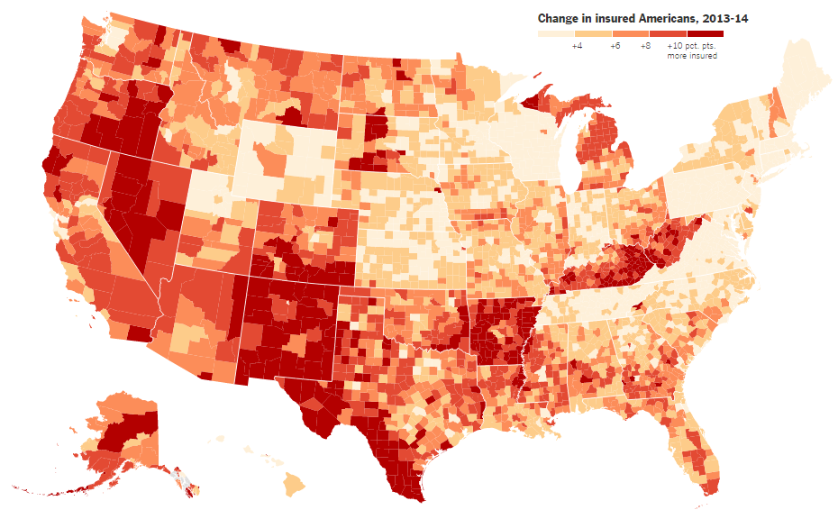
Obama’s Health Law
Who Was Helped Most?
Image source: https://www.nytimes.com/interactive/2014/10/29/upshot/obamacare-who-was-helped-most.html
Notes:
A new data set provides a clearer picture of which people gained health insurance under the Affordable Care Act. We know that about 10 million more people have insurance coverage this year as a result of the Affordable Care Act. But until now it has been difficult to say much about who was getting that coverage — where they live, their age, their income and other such details.
Now a large set of data — from Enroll America, the group trying to sign up people for the program, and from the data firm Civis Analytics — is allowing a much clearer picture. The data shows that the law has done something rather unusual in the American economy this century: It has pushed back against inequality, essentially redistributing income — in the form of health insurance or insurance subsidies — to many of the groups that have fared poorly over the last few decades.
The biggest winners from the law include people between the ages of 18 and 34; blacks; Hispanics; and people who live in rural areas. The areas with the largest increases in the health insurance rate, for example, include rural Arkansas and Nevada; southern Texas; large swaths of New Mexico, Kentucky and West Virginia; and much of inland California and Oregon.
Each of these trends is going in the opposite direction of larger economic patterns. Young people have fared substantially worse in the job market than older people in recent years. Blacks and Hispanics have fared worse than whites and Asians. Rural areas have fallen further behind larger metropolitan areas.
Women are the one modest exception. They have benefited more from Obamacare than men, and they have received larger raises in recent years. But of course women still make considerably less money than men, so an economic benefit for women still pushes against inequality in many ways.
The Affordable Care Act was passed in 2010, but the law’s biggest insurance expansion provisions went into effect in January, when millions more people qualified for state Medicaid programs, and new subsidized insurance plans sold in state marketplaces kicked in.

Slide 33
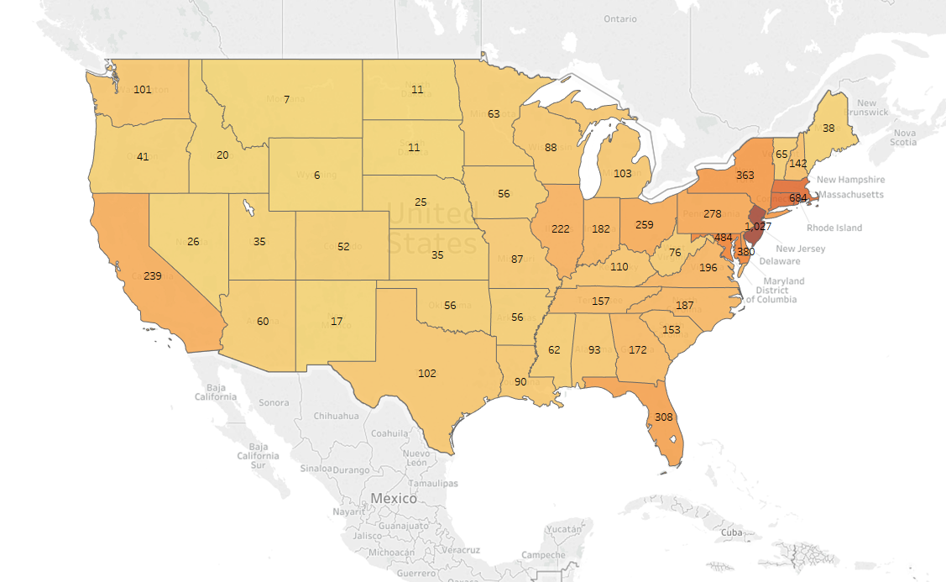
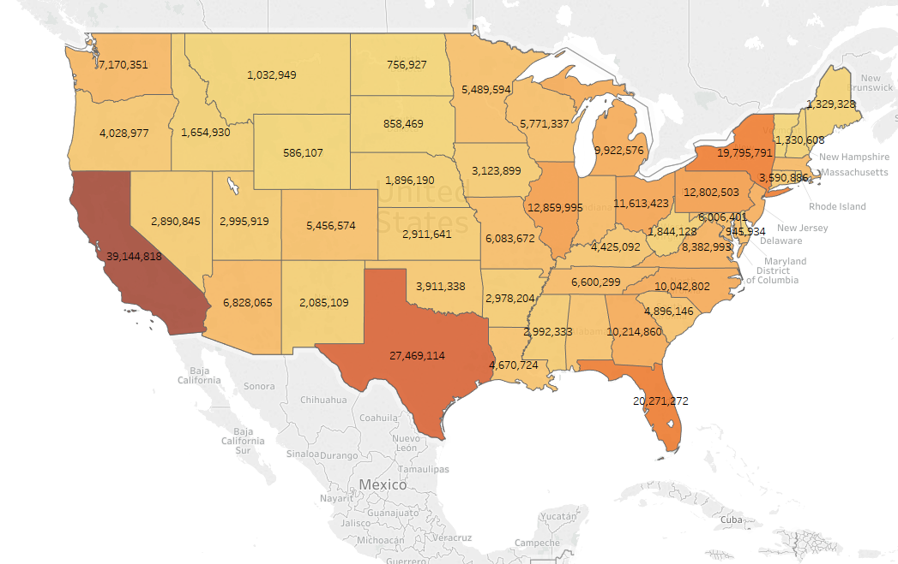
Exercise: USA Population Statistics
Use Tableau to display:
USA states by population (already done)
USA states by population per square mile
Notes:
File in Moodle.
A common error when producing Choropleth Maps is to encode raw data values (such as population) rather than using normalized values (calculating population per square kilometer for example) to produce a density map.

Slide 34
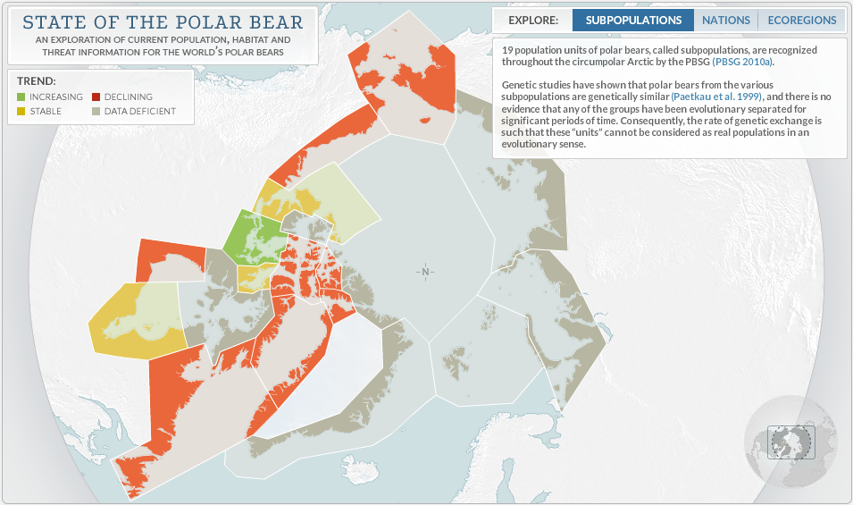
Displaying “Nothing”
Image source: http://works.periscopic.com/pbsg/
Notes:
Note “Data Deficient” – displayed in grey. “A subtle but quite effective political point is being made here” (Kirk, 2016).
Distinguish between “nothing” and a “zero” value.

Slide 35
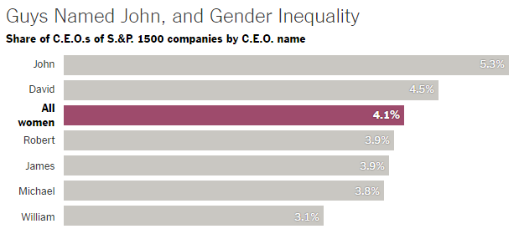
Editorial Salience
Draw viewer’s attention to the significant or meaningful features of your display
Colour
Potent visual stimulus
Influential means for drawing out key aspects of your data
Make prominent
Image source: https://www.nytimes.com/2015/03/03/upshot/fewer-women-run-big-companies-than-men-named-john.html
Notes:
Graphic (Kirk, p276)
Angle of analysis shows a summary of the most prevalent men’s names featured among CEOs of S&P companies. More Johns and Davids than ALL WOMEN!
Startling statement of inequality – the bar for “All Women” is emphasized in a burgundy colour contrasting with the grey bars for the men’s names. Note bold font on bar value label further accentuates the emphasis.
This is SHOUTING!

Slide 36
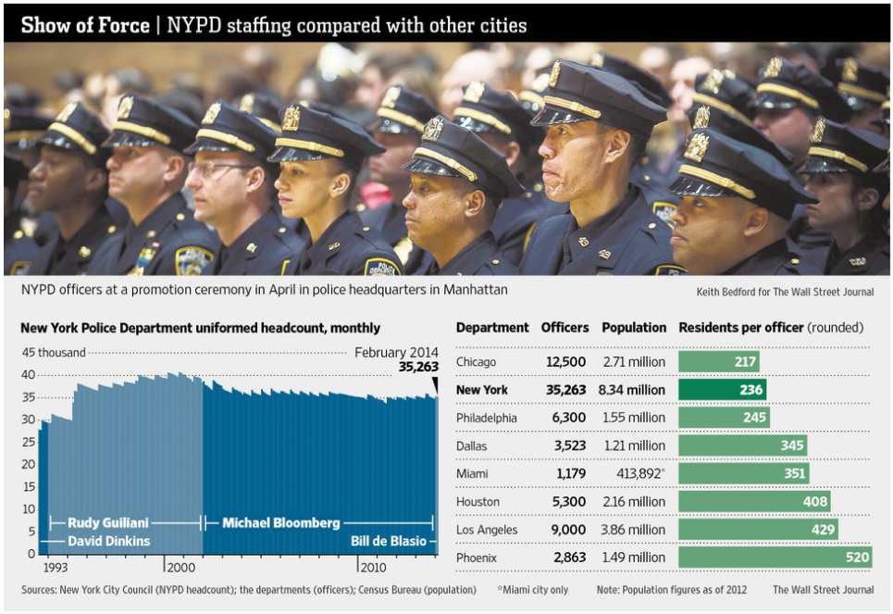
Editorial Salience
Noticeable contrast sometimes more appropriate
Example:
Slightly darker shade of green for “New York”
Emphasizes NY compared to other cities
Sufficiently noticeable
Image source: http://www.wsj.com/news/interactive/NYPD0521
Notes:
This is not shouting.

Slide 37
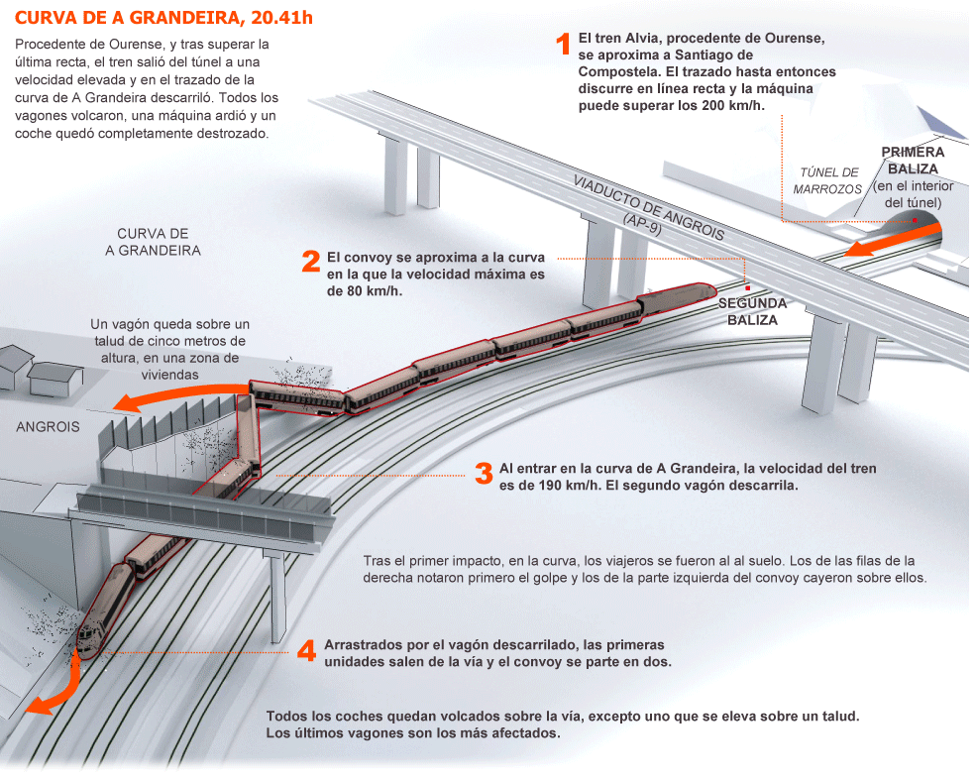
Functional Harmony
Ensure colour choices will aid, and not hinder, the functional effectiveness and elegance of the overall visualization
Annotations:
Can enhance visualization
Find level at which it is suitably prominent
Not loud, just hidden, just at the right level
Image source: http://elpais.com/elpais/2013/07/25/media/1374703338_483146.html
Notes:
Lot of grey here, but annotations are pitched at right level.
Full graphic located at: http://elpais.com/elpais/2013/07/25/media/1374703338_483146.html

Slide 38
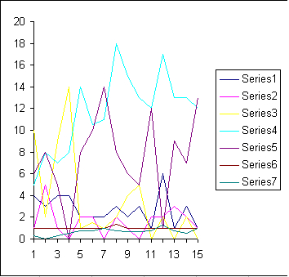
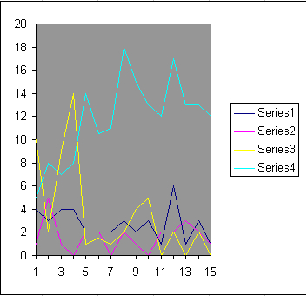
Effective Use of Colour in Visualization (Ward et al, 2015)
If the visualization task involves absolute judgement, keep the number of distinct numeric levels low
Too many colours versus a moderate number of colours.
Notes:
In summary…
Verbatim from “Interactive Data Visualization” by Ward, Grinstein, & Keim (2015).
All images from: http://www.idvbook.com/teaching-aid/figures/chapter-12/

Slide 39
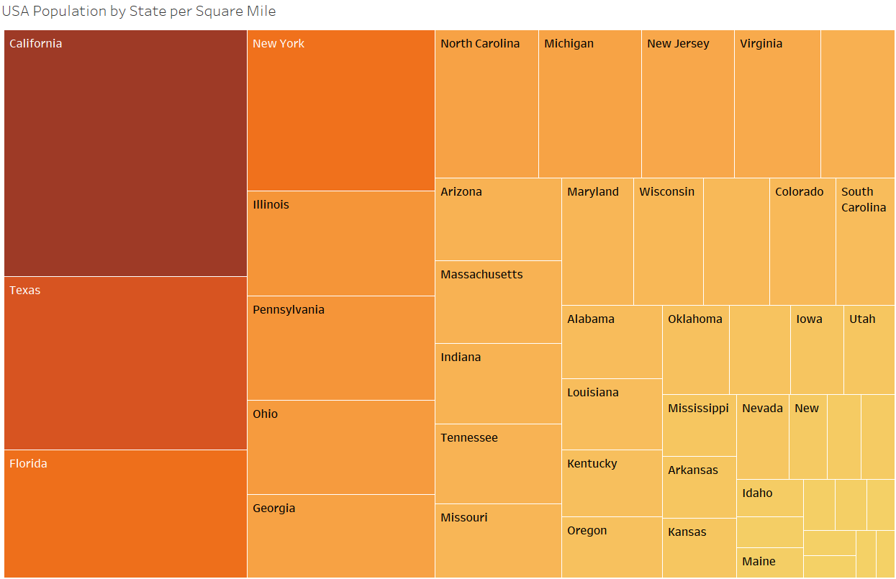
Effective Use of Colour in Visualization (Ward et al, 2015)
Use redundant mappings if possible (map a particular field to both colour and size)
Notes:
Verbatim from “Interactive Data Visualization” by Ward, Grinstein, & Keim (2015).
All images on this slide and the next four from: http://www.idvbook.com/teaching-aid/figures/chapter-12/
Image from exercise – drawn in Tableau.

Slide 40
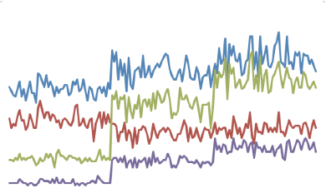
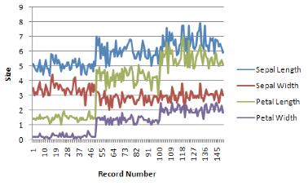
Effective Use of Colour in Visualization (Ward et al, 2015)
Include a labelled colour key to help users interpret the colours
A complex visualization with and without captions/ticks/legends.
Notes:
Verbatim from “Interactive Data Visualization” by Ward, Grinstein, & Keim (2015).
All images on this slide from: http://www.idvbook.com/teaching-aid/figures/chapter-12/
Image from exercise – drawn in Tableau.

Slide 41
Effective Use of Colour in Visualization (Ward et al, 2015)
When possible, use semantically resonant colours in the visualization – these will be easier for users to learn and remember
Notes:
Verbatim from “Interactive Data Visualization” by Ward, Grinstein, & Keim (2015).

Slide 42
Exercise
Select a sample visualisation or infographic project and identify all the ingredients of colour usage on display.
Pretend you are now the designer working up some new colour choices in the face of having to accommodate new contextual factors, how might you colour this project if…
You had to demonstrate the worst possible data visualisation colour practices
You had to force yourself to use as few different colours as possible?
You had to make it work for non-colour printing?
(if you began with a colour property of red or green) you now have to make it red-green colour-blind friendly?
(if your chosen project was related, in any way, to a specific organisation) you now have to use only their corporate colours
Notes:
Do a Google image search for “infographics”.

